Slide 1
Characterizing a Spring Pendulum with Monte Carlo Methods
Dawn Sargent and Mattison Johnson
Fairmont state university
May 16, 2018

Slide 2






Special thanks

Slide 3


Monte Carlo
Useful for numerically modeling physics-related problems
Especially valuable in a high dimensional parameter space
After we identify meaningful ranges for each parameter, the algorithm randomly chooses from each range
Able to obtain results very close to the actual expected outcomes and their associated probabilities
Law of Large Numbers
Find needed probabilities “empirically”

Slide 4
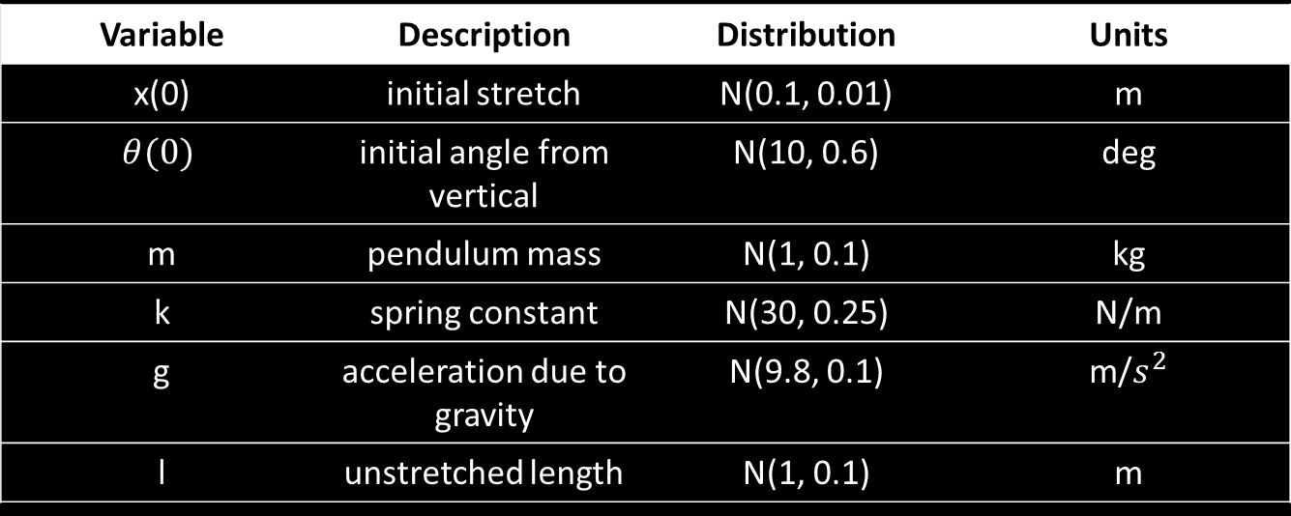

The Problem
What makes a spring pendulum result in chaotic motion?
$$x^{′′}+ \frac{k}{m}x −\left(l+x\right){θ^{′}}^{2}+gcos\left(θ\right)=0$$
$$θ^{′′}+ \frac{gsin\left(θ\right)+2x′θ′}{l+x}=0$$
Variable | Description | Distribution | Units
x(0) | initial stretch | N(0.1, 0.01) | m
$$θ(0)$$ | initial angle from vertical | N(10, 0.6) | deg
m | pendulum mass | N(1, 0.1) | kg
k | spring constant | N(30, 0.25) | N/m
g | acceleration due to gravity | N(9.8, 0.1) | m/$s^{2}$
l | unstretched length | N(1, 0.1) | m

Slide 5
Converting to System of 1st order equations
1st equation
2nd equation

Slide 6
Code
scipy.integrate.odeint
Integrate a system of ODEs
dy/dt = func(y, t0, t, args, … )
def pend(I, t, m, k, l, g):
dy1dt = I[1] # y1' = y2 = x’
dy2dt = (-k/m)*I[0] + (l+I[0])*(I[3])**2 + g*math.cos(I[2]) # y2' = x"
dy3dt = I[3] # y3' = y4 = theta’
dy4dt = (-g*math.sin(I[2]) - (2.0*I[1]*I[3])) / (l+I[0]) # y4' = theta"
return [dy1dt, dy2dt, dy3dt, dy4dt]
…
t = np.linspace(0, totTime, numSteps) # time array
…
# Calling odeint
results = DataFrame(integrate.odeint(pend, initial_conditions, t, args=(mass, spring, length, gravity)))

Slide 7

Existence & UNIQUENESS
Taken from pg. 350 of The Theory of Differential Equations: Classical and Quantitative (2nd ed.) by W. Kelley and A. Peterson
Picard-Lindelof Theorem:
Assume that f is a continuous n-dimensional vector function of the rectangle
Q := {(t,x) : t₀ ≤ t ≤ t₀ + a, ‖x-$x_{0}$‖ ≤ b}
and assume that f(t,x) satifies a uniform Lipschitz condition with respect to x on Q. Let
M := max{ ‖ f(t,x) ‖ : (t,x) $∈$Q }
and
$α$ := min{a, $\frac{b}{M}$}.
Then the initial value problem has a unique solution x on [t₀, t₀ + $α$].
Furthermore,
‖x(t) - $x_{0}$‖ ≤ b,
for t $∈$ [t₀, t₀ + $α$].

Slide 8
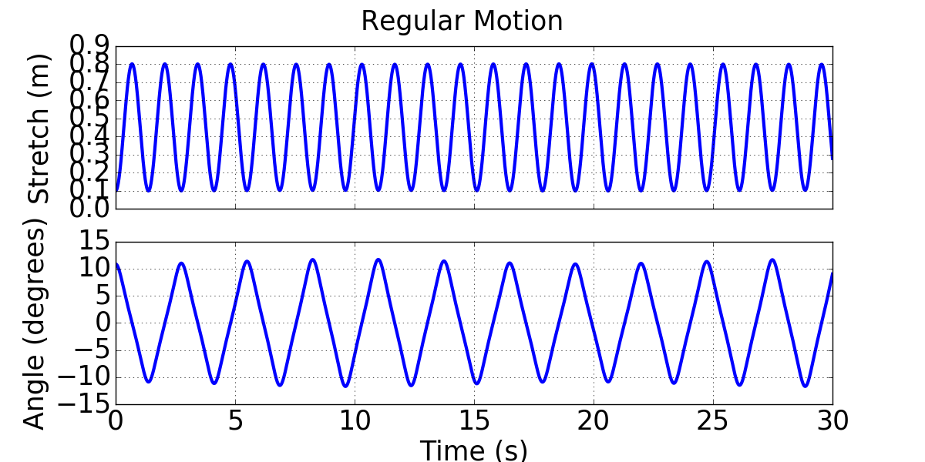
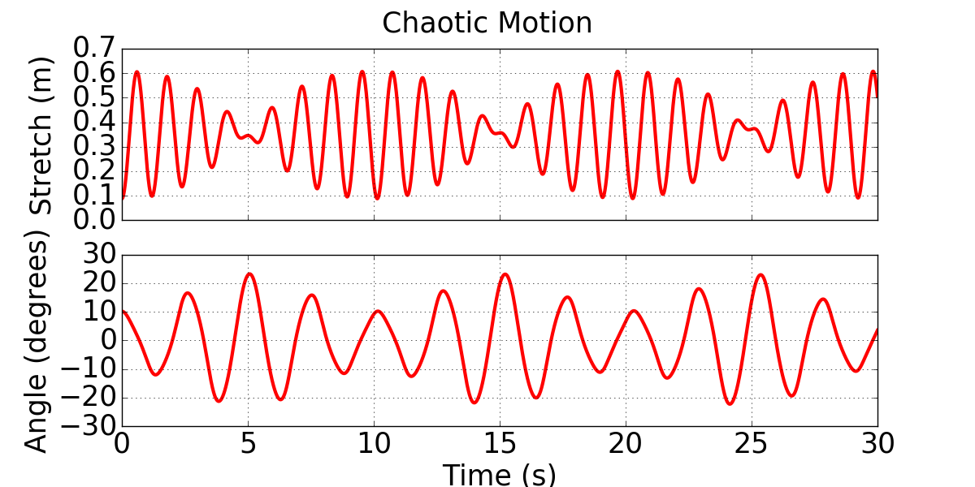

Performance Metric
In order to identify what parameters affect the success of a trial, we must first determine what will define a success versus a failure.
Performance metric: If the max angle exceeds 21$°$, it is chaotic.
Motion | Gravity | Initial Angle | Initial Stretch | Length | Mass | Spring
Regular | 9.82 | 6.31 | 0.121 | 0.8044 | 1.207 | 30.131
Chaotic | 9.73 | 10.16 | 0.088 | 1.065 | 1.058 | 29.79

Slide 9

Data analysis

Slide 10

Python packages
SciPy
Scikit-learn
Numpy
Pandas
Matplotlib
This Photo by Unknown Author is licensed under CC BY-SA

Slide 11
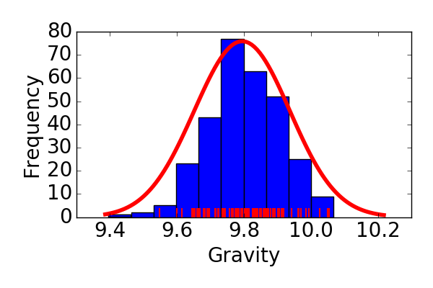
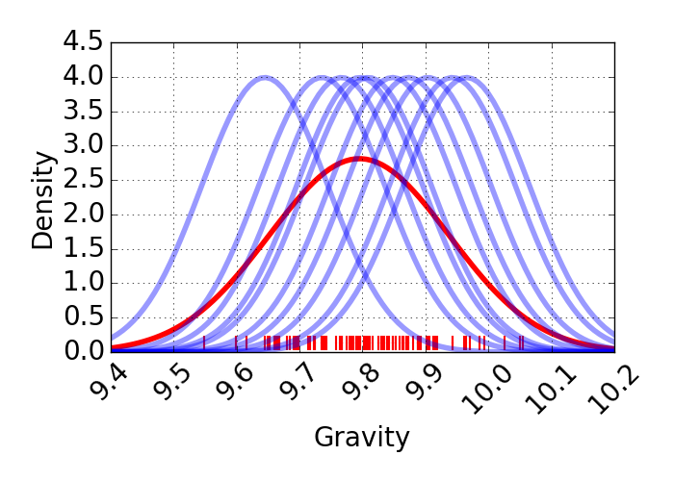
Kernel density estimate
What is a kernel density estimate?

Slide 12
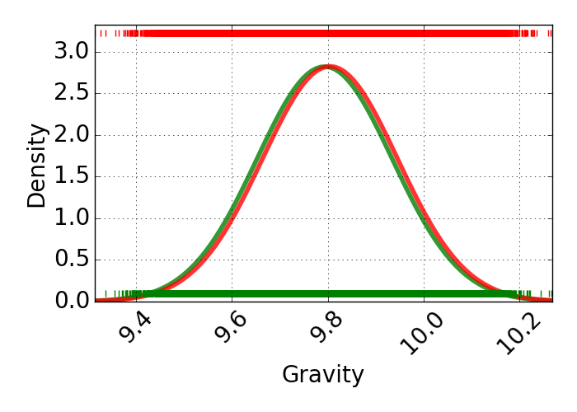
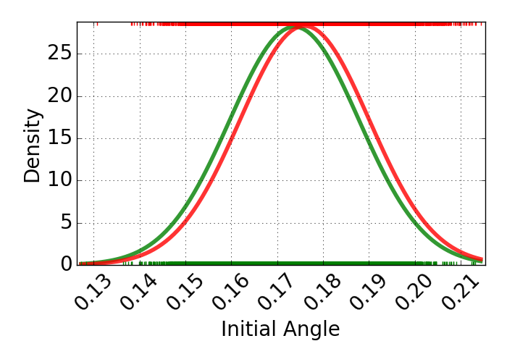
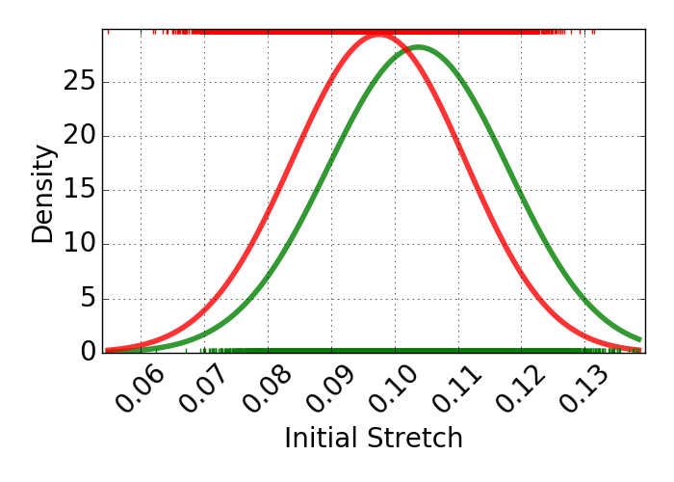
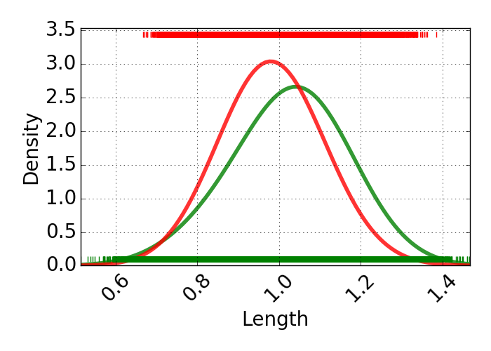
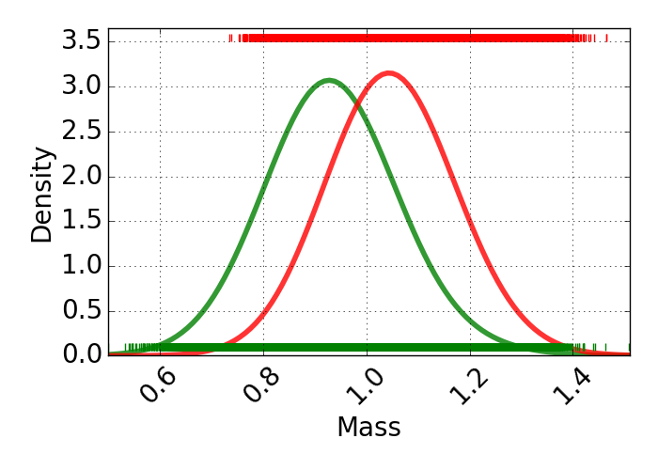
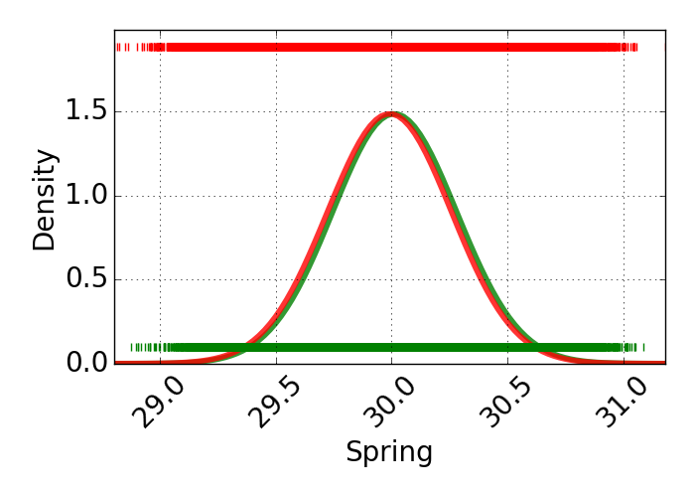
KDE

Slide 13

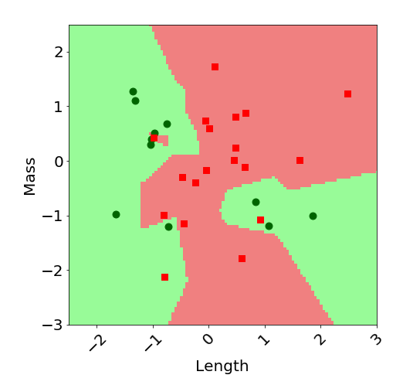
K-Nearest neighbors
What is the k-nearest neighbor method?

Slide 14

Optimization
Split the data
75% training
Fit the classifier
25% testing
Get predictions
Compare

Slide 15
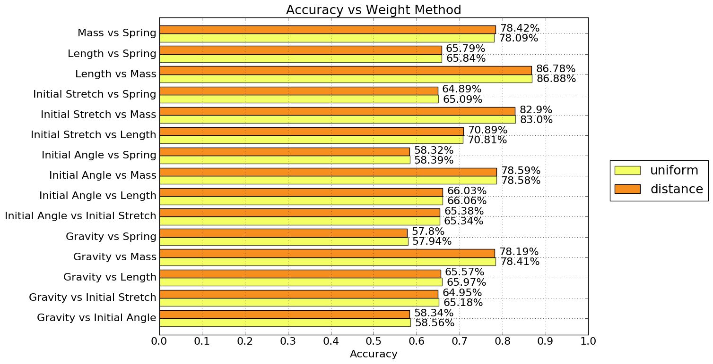

Slide 16
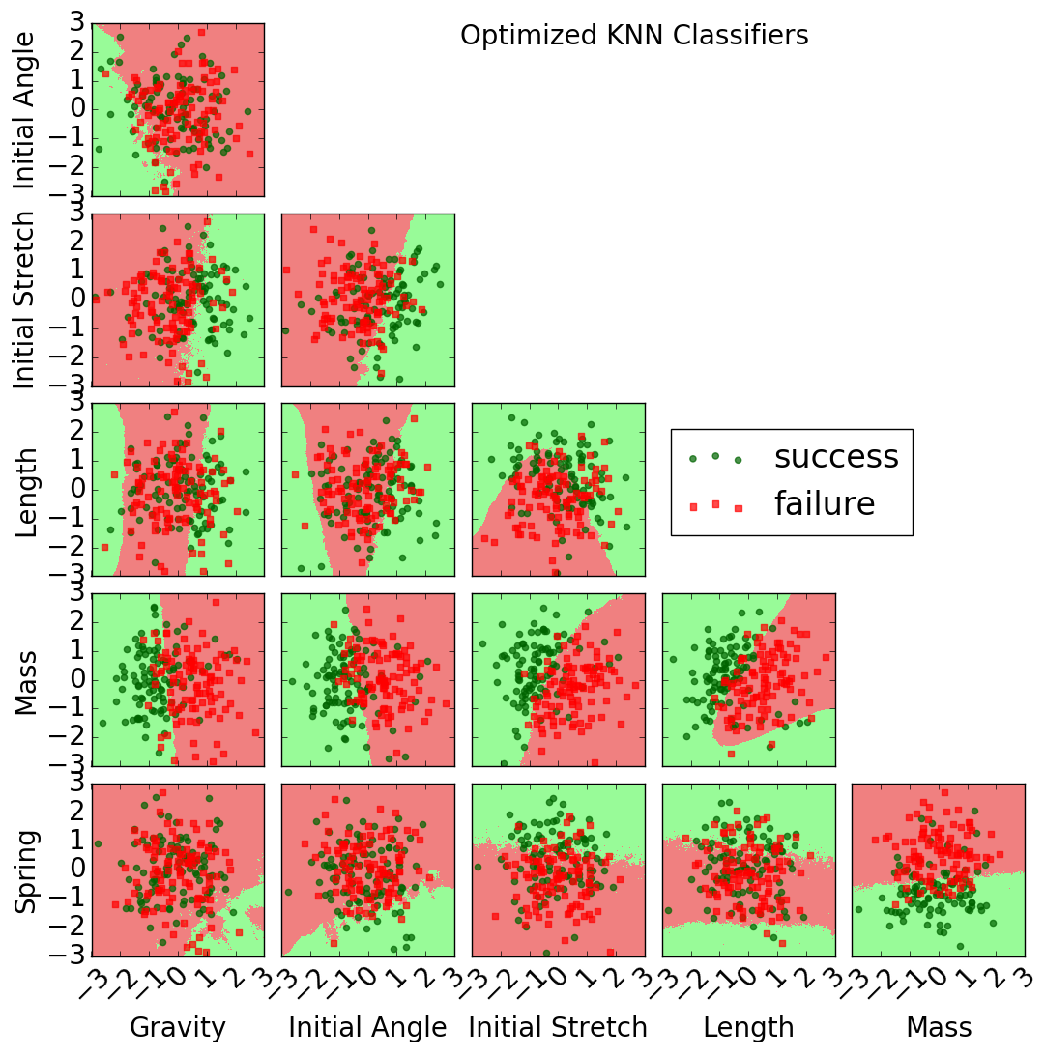
KNN

Slide 17
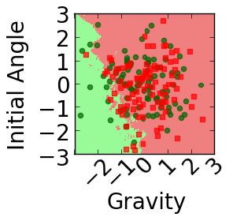
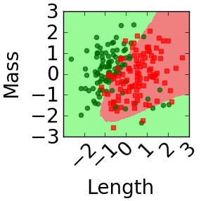

Slide 18
Accuracy
Parameters | Accuracy
Mass vs Length | 86.88%
Mass vs Initial Stretch | 83.00%
Mass vs Initial Angle | 78.59%
Mass vs Spring | 78.42%
Mass vs Gravity | 78.41%
Length vs Initial Stretch | 70.89%
Length vs Initial Angle | 66.06%
Length vs Gravity | 65.97%
Length vs Spring | 65.84%
Initial Stretch vs Initial Angle | 65.38%
Initial Stretch vs Gravity | 65.18%
Initial Stretch vs Spring | 65.09%
Initial Angle vs Gravity | 58.56%
Initial Angle vs Spring | 58.39%
Spring vs Gravity | 57.94%

Slide 19
Conclusion
Able to characterize the motion of a spring pendulum using
Monte Carlo Method
Data Mining
Machine Learning
Spring pendulum behavior cannot be predicted effectively using a single parameter
Conclusions about spring pendulum behavior could be drawn from the KNN, but not the KDE
Uniform vs Distance weight methods have no discernible difference
Mass and Length together are the best predictors of spring pendulum behavior

Slide 20

Further investigation
Step sizes, computation time
Error
Parallel processing
Other machine learning methods

Slide 21

contact
Dawn Sargent
dsargent@students.fairmontstate.edu
Mattison Johnson
mjohnson57@students.fairmontstate.edu

